Slide 1


ShapeFlow Monitor
Gal Bitton
Eyal Maklada
Adir David
Nadav Reubens
Ron Sisso

Slide 2

60 Seconds About ShapeFlow - Monitor

Slide 3
Background
Utilization of Firebase, Google Colab and OnShape
Allows the users to analyze Graphs and Log files.
Multiple features such as Glossary, Chatbot, Alerts, Dynamic Graphs and more.
A Cloud based web application designed for analyzing and displaying OnShape users data.

Slide 4
Non-Functional Requirements
Classification | Requirement
Deployment Ease | The application will be easy to deploy and install across various environments.
User Experience | The application will provide a high-quality user experience, featuring a modern and pleasant user interface.
Resource Usage | The application will efficiently utilize computer resources, avoiding excessive load on the CPU, memory, and storage.
Transparency | The application will ensure full transparency of actions and information within the system, including detailed logging and change tracking.
Customization | The application will allow users to customize functions and interfaces to meet specific individual needs.
Performance, Response Time, Efficiency, and Resource Constraints | The application will deliver responsive performance with real-time updates and minimal latency.
Usability | The application will feature a user-friendly and intuitive interface, enabling easy and straightforward navigation.

Slide 5
Homework Analysis
HW1
HW2
Planned Features
Planned Features
Central Dashboard
Visual display of key project data
Real-Time Alerts
Notifications for significant activities
Undo Action Analysis
Insight into time-wasting actions
Working Hours Analysis
Details user working hours data
Multi-Json File Handling
Upload and switch between multiple JSON files
System Logger
Comprehensive logging of critical system actions and events
Acceptance Tests
Acceptance Tests
Verify
Verify central dashboard displays all relevant data correctly
Ensure
Ensure real-time alerts function properly
Confirm
Confirm undo action analysis provides accurate insights
Validate
Validate working hours analysis displays correct data
Test
Test multi-JSON file handling for proper upload and switching
Verify
Verify system logger records all actions accurately

Slide 6
Exclusive Features
Alerts – Indicating Unique Work Habits & Patterns
Support Multiple Logs & Inter-switching
Dynamic Graphs
Collapsible Lists – Detailed and Comprehensive Data Points

Slide 7
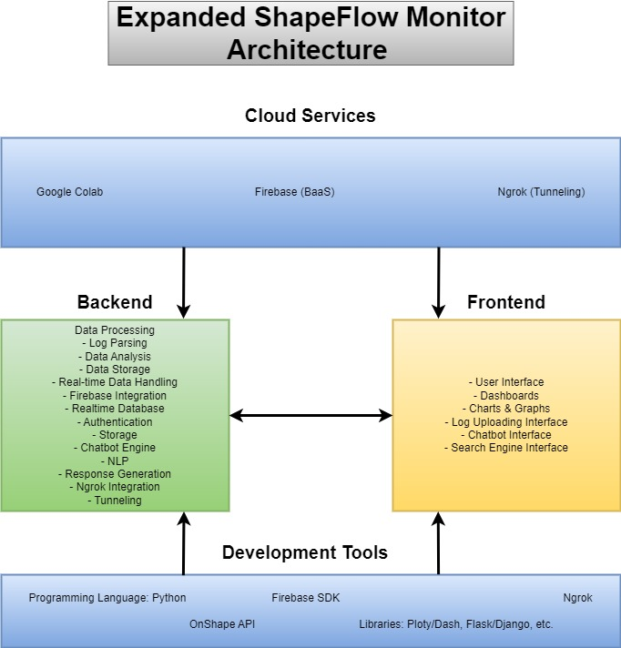
Architecture

Slide 8
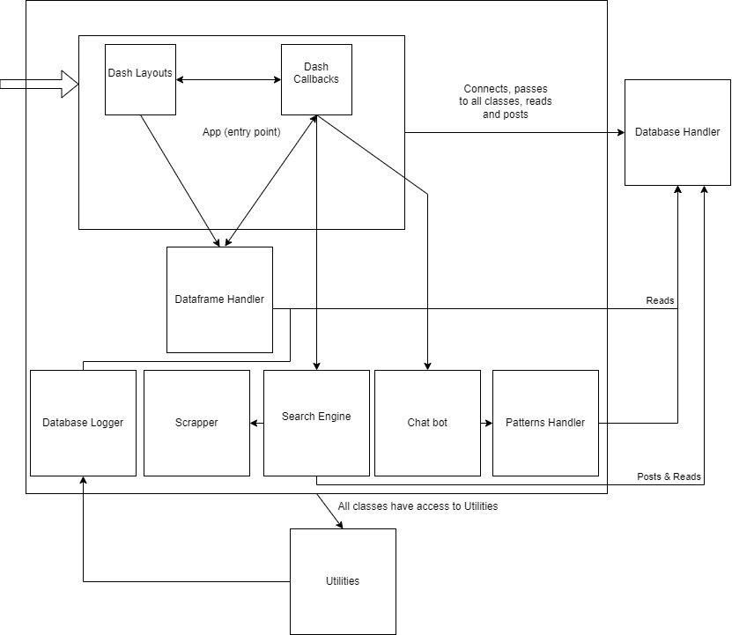
Architecture (cont.) - Flow

Slide 9
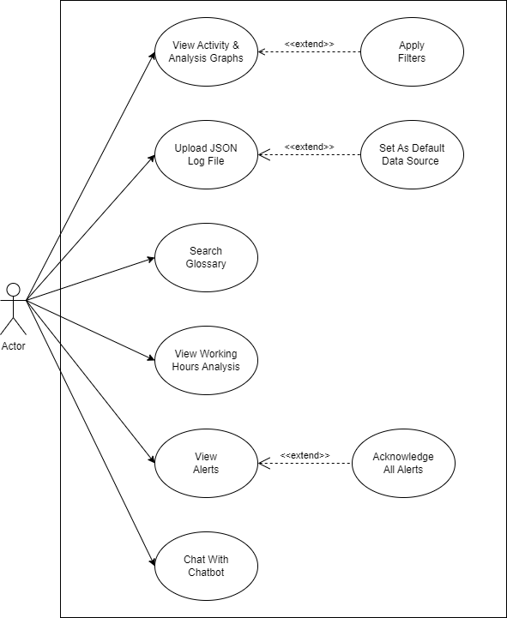
Use Case

Slide 10
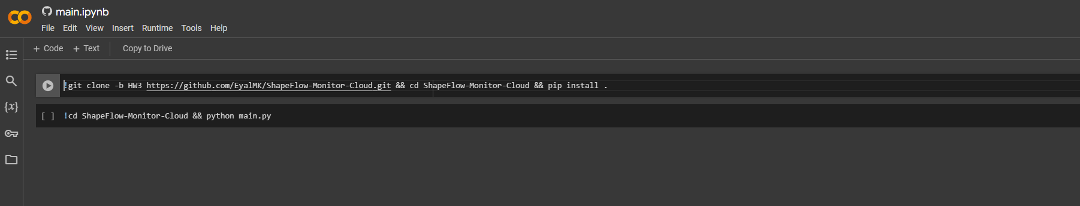
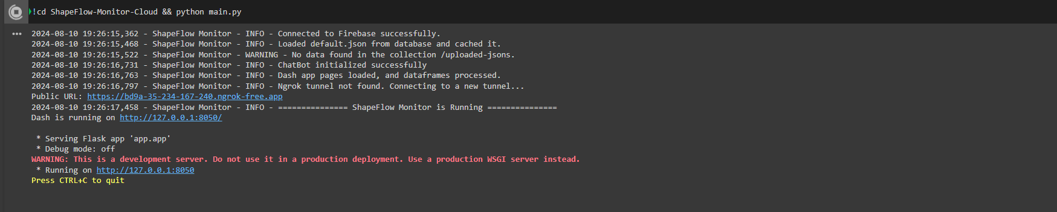
Project Setup
https://colab.research.google.com/github/EyalMK/ShapeFlow-Monitor-Cloud/blob/HW3/main.ipynb
Application URL

Slide 11
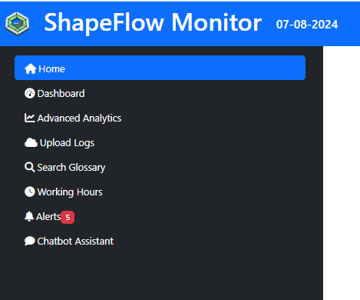
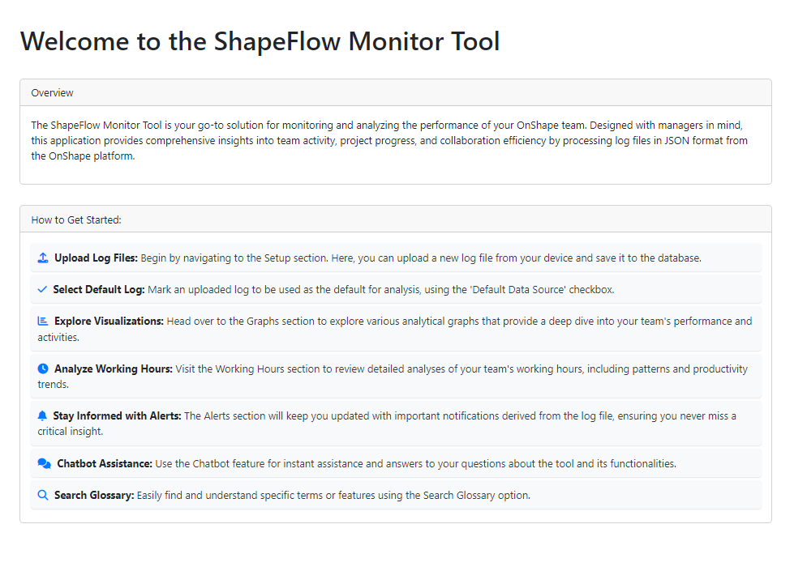
Landing pages
Operations Alerts
Sidebar-Menu Navigation

Slide 12
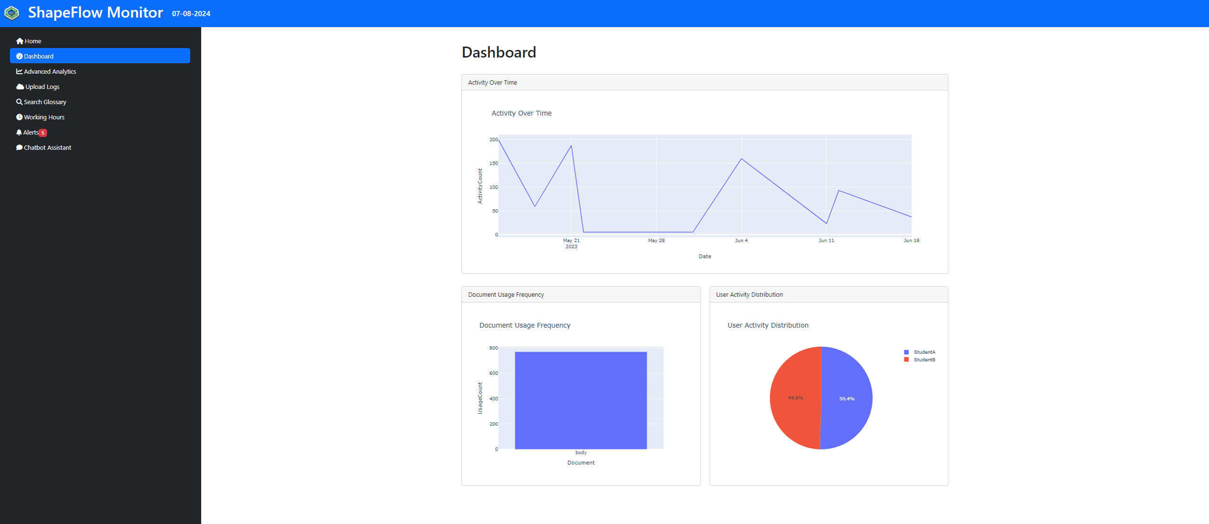
Dashboard
Count Actions Over Time
Action Count in Document
User Action Count

Slide 13
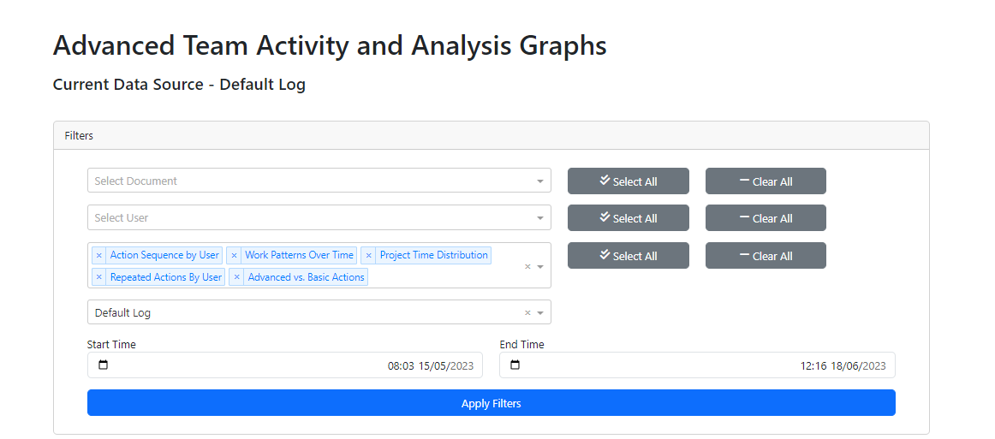
Advanced Analytics

Slide 14
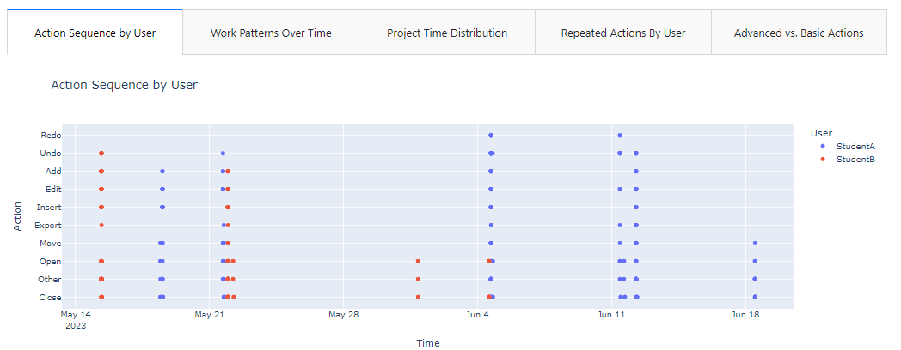
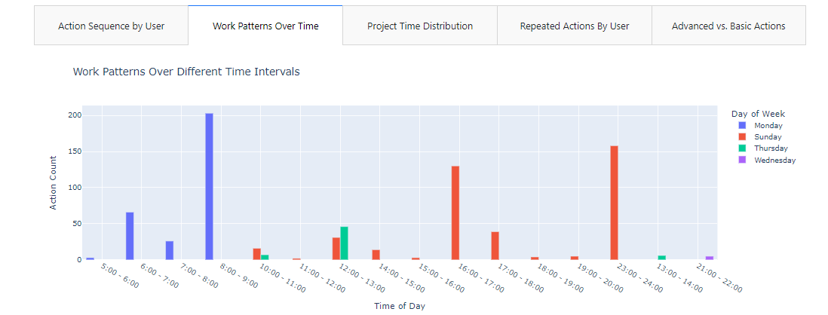
Advanced Analytics

Slide 15
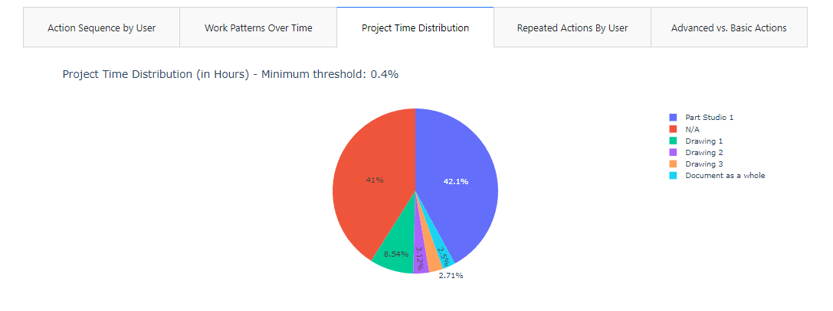
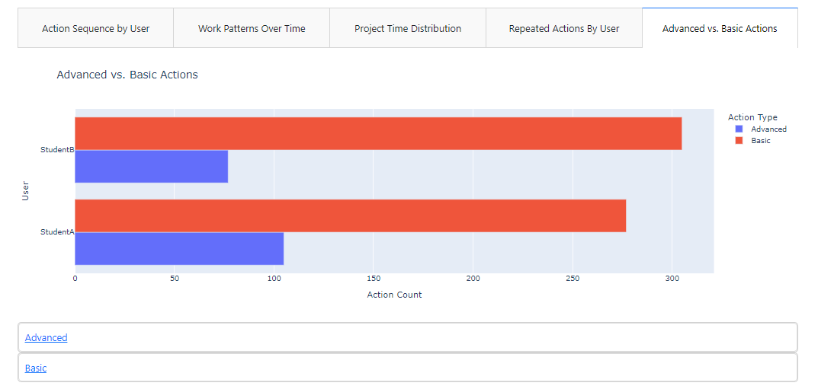
Advanced Analytics

Slide 16
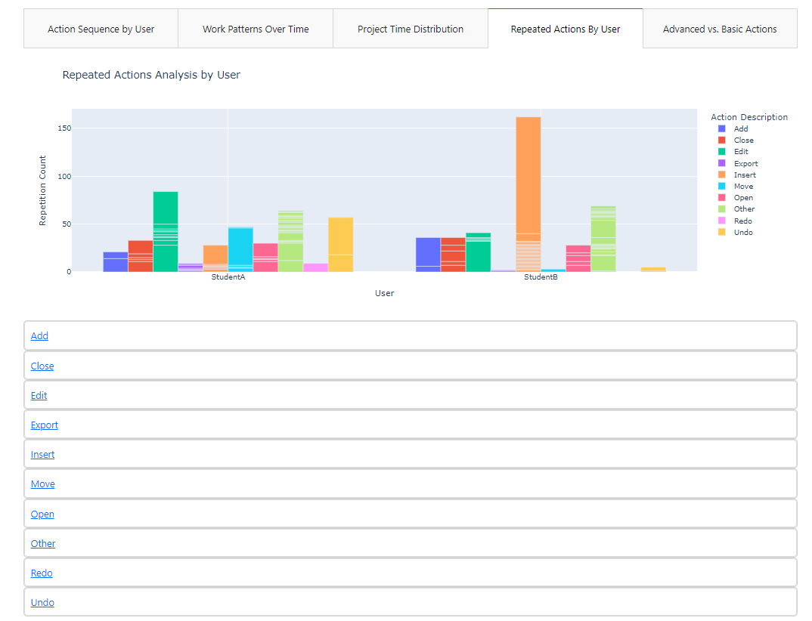
Advanced Analytics

Slide 17
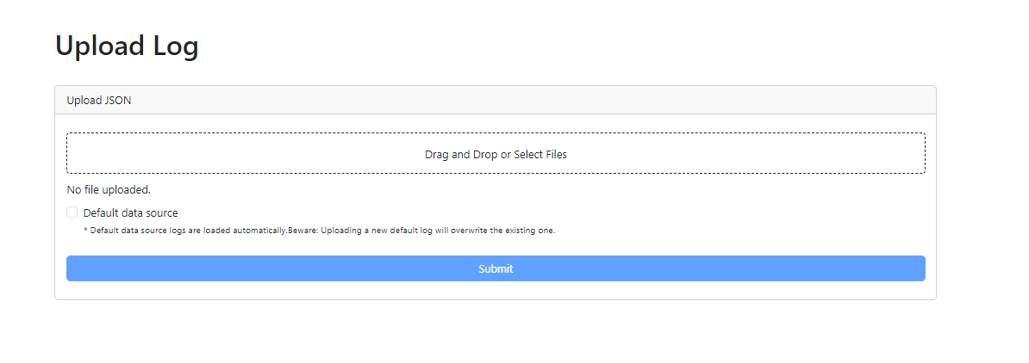
Upload Logs
Drag Files Here
OR
Double Click to Select
Mark Log as Default

Slide 18
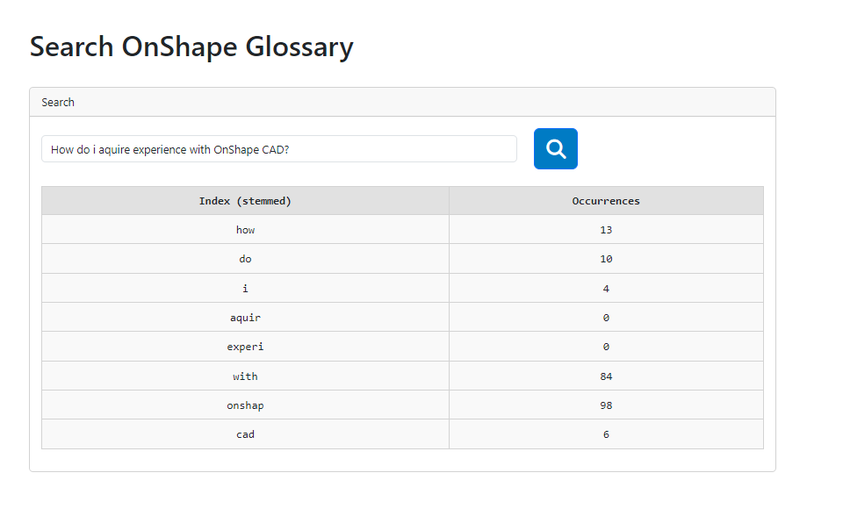
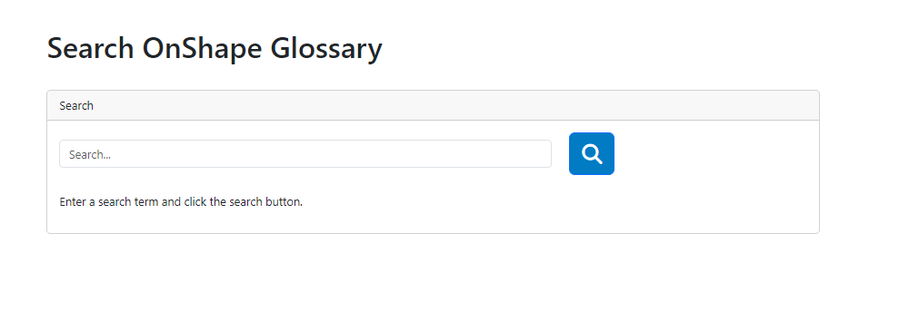
Search Glossary

Slide 19
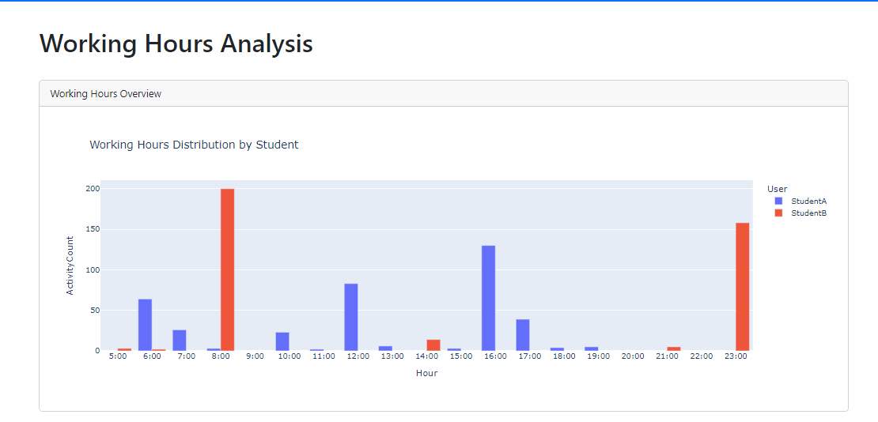
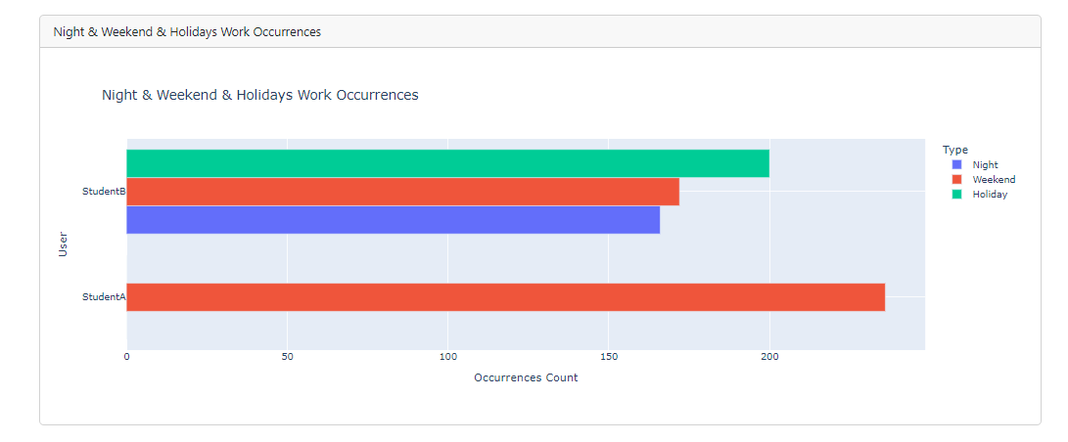
Working Hours
User Activity Count Outside Work Hours
User Actions Count For Each Hour

Slide 20
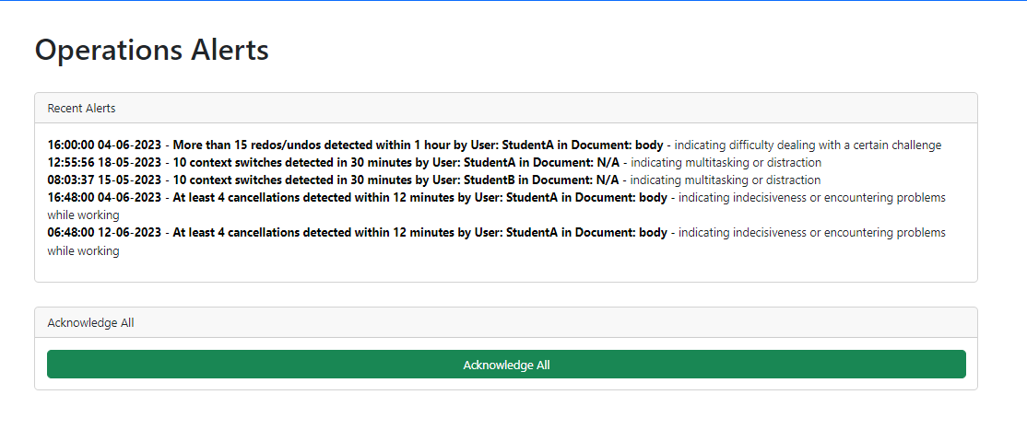
Alerts
Important Indicators
Mark as Read

Slide 21
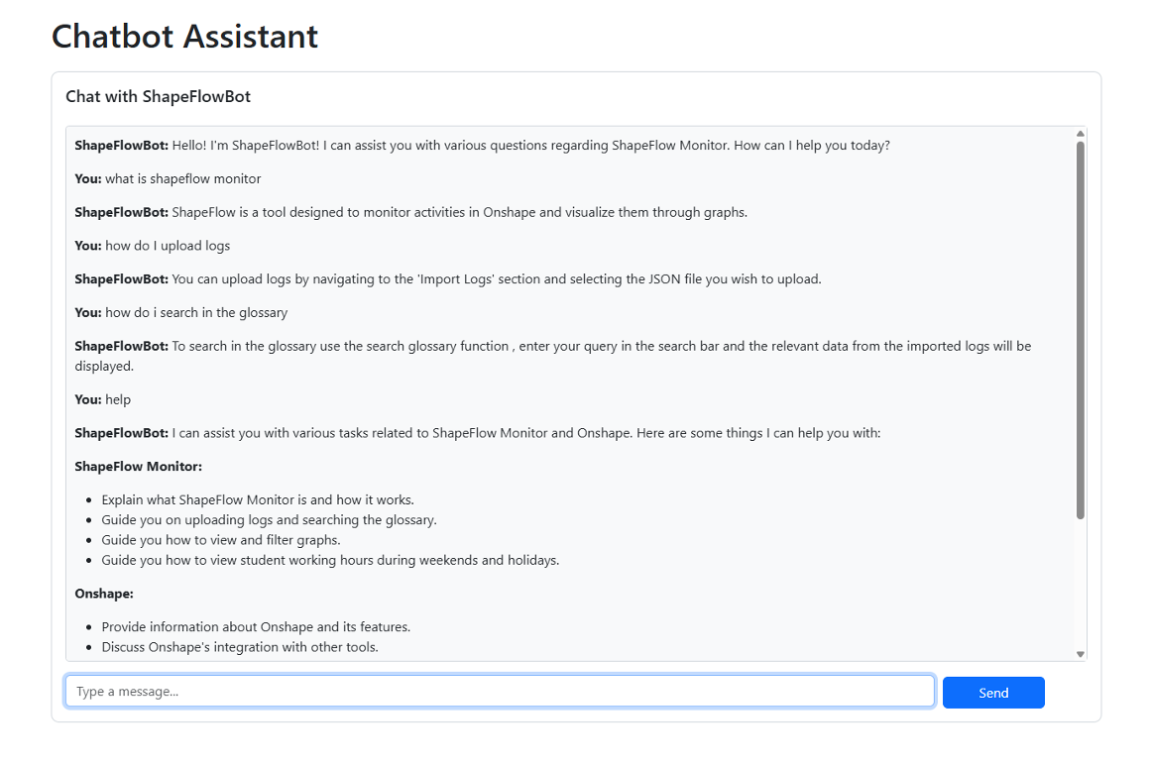
Chatbot Assistant

Slide 22
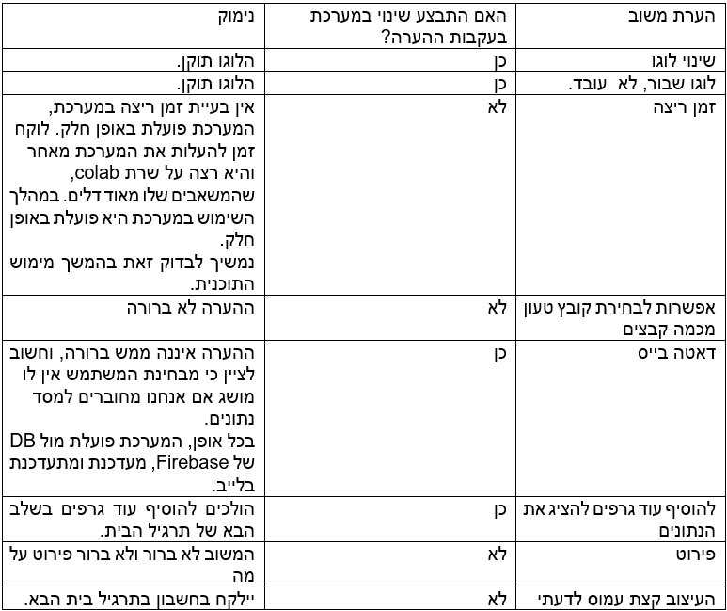
Peer Review

Slide 23
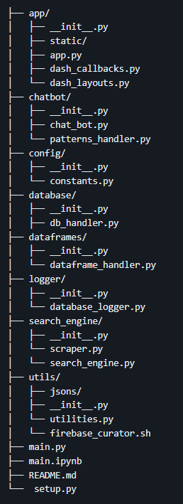
Modular Code
Time Windows & Thresholds are configurable.
Comprehensive Error Handling
Error Logger – For Hands-On Maintenance
Concise Code Structure
Highly Reusable Components
Built to deal with Generic “OnShape” Data

Slide 24

Thank You For Listening!

